Slide 1

DIGITAL MARKETING STRAGETGY EVALUATION
ARTEA
TEAM 16
Ann Gray Perdue, Molly McDade
Luke White, John Carl Tagbor,
Notes:
AG

Slide 2


Coupon Campaign Goal:
Target Ethically
Increase Revenue
Notes:
AG – for our strategy, we focused primarily on two main objectives. To target ethically, but more importantly, increase revenue because that is the main reason for the company's exixtence.

Slide 3
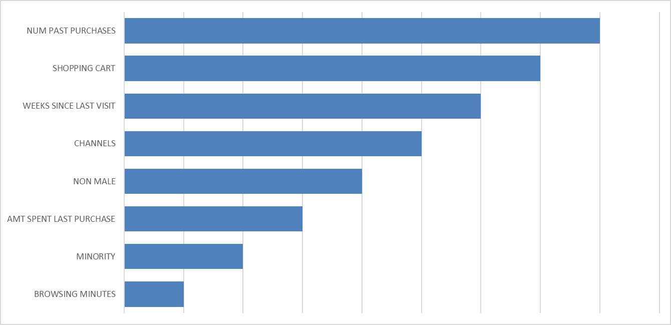
Significance for Revenue:
Notes:
AG

Slide 4
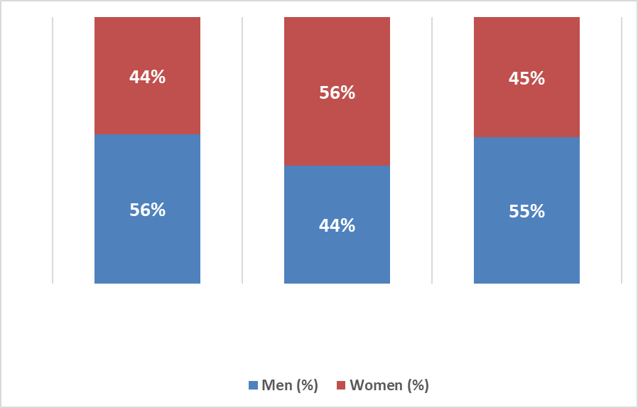



Channel by Gender:

Slide 5
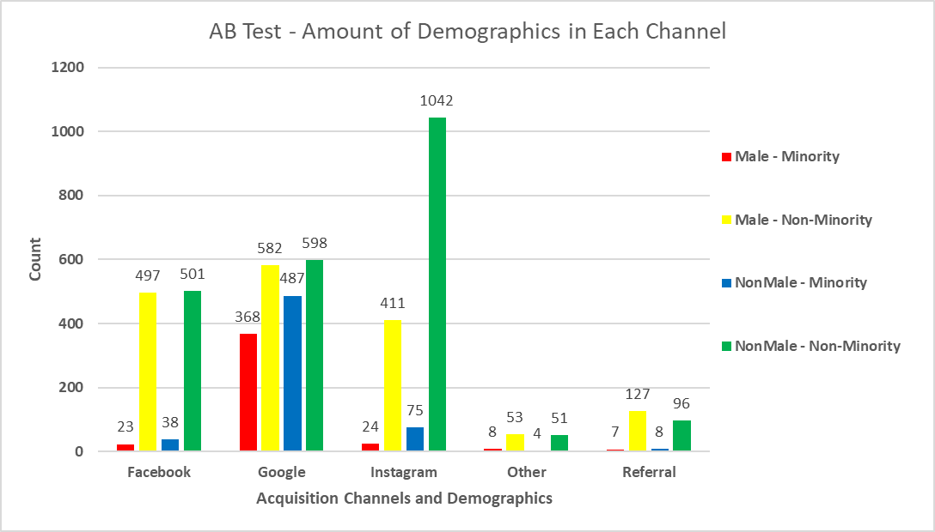
Old Campaign – Who Had Coupons?

Slide 6
Old Campaign – Who Was Excluded?
49.96%
Of Sample
50.58%
Of Minority Customers
50.10%
Of Non-Male Customers

Slide 7

Old Campaign – Who Was Included?
50.10%
Of Sample
49.42%
Of Minority Customers
49.90%
Of Non-Male Customers
... but no significant impact on revenue
Notes:
Split well but revenues didn’t get helped

Slide 8
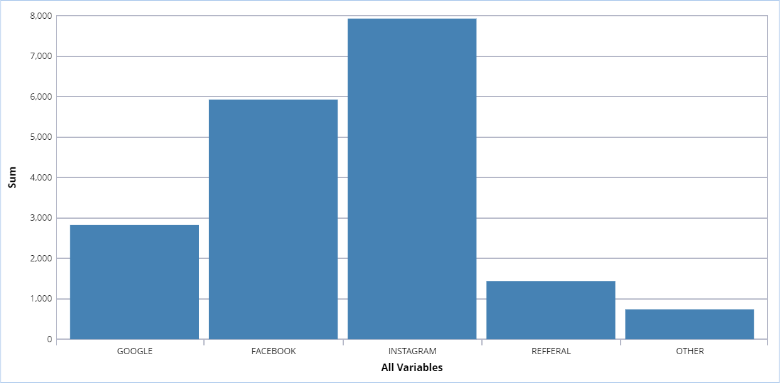
Coupon Performance by Channel

Slide 9



New Campaign Methodology
Target customers by platform and abandoned shopping carts.
Notes:
LW

Slide 10
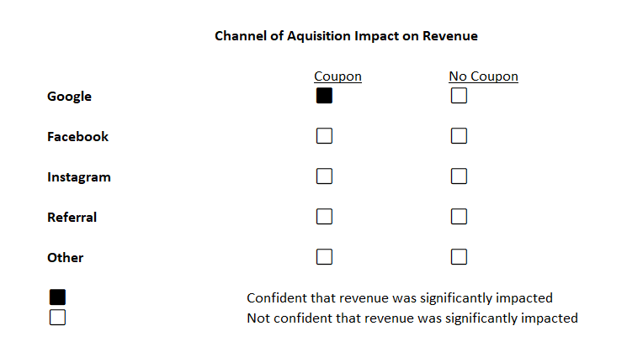
Notes:
LW
We found that google revenues were impacted by coupons to a significant degree, but after doing further research, we found a customer segment that was impacted more significantly

Slide 11
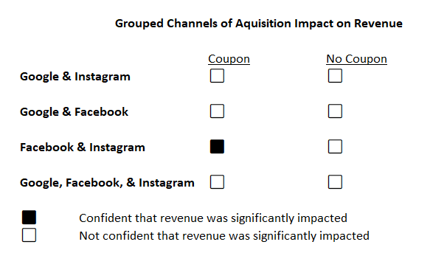
Notes:
LW

Slide 12
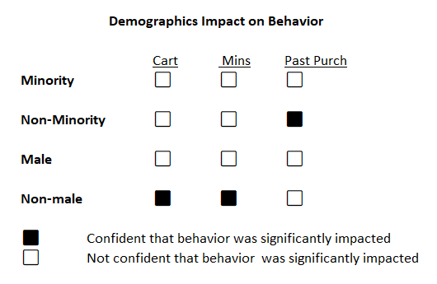
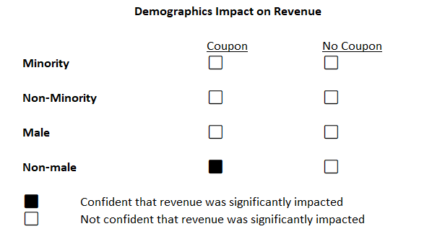
Notes:
LW

Slide 13
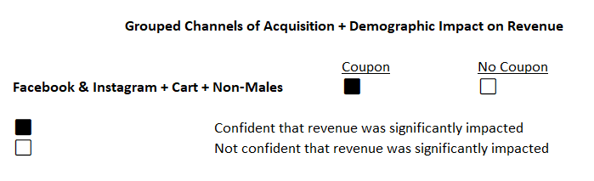
Notes:
LW

Slide 14




New Campaign Strategy
Facebook
Instagram
Abandoned
Carts
Non-Males

Slide 15
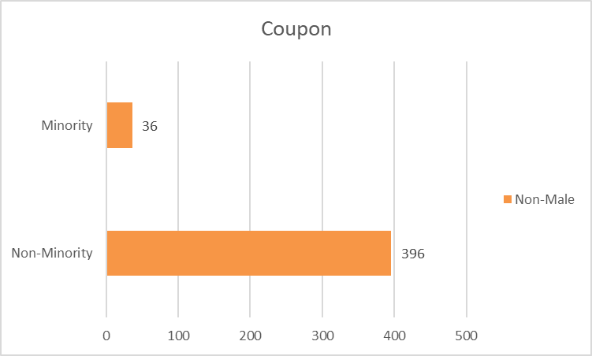
New Campaign – Who Had Coupons?
7%
Of Sample (Channels 2 & 3)
3%
Of All Minority Customers
32%
Of Minority Customers from Channels 2 & 3
12%
Of All Non-Male Customers
22%
Of Non-Male Customers from Channels 2 & 3

Slide 16
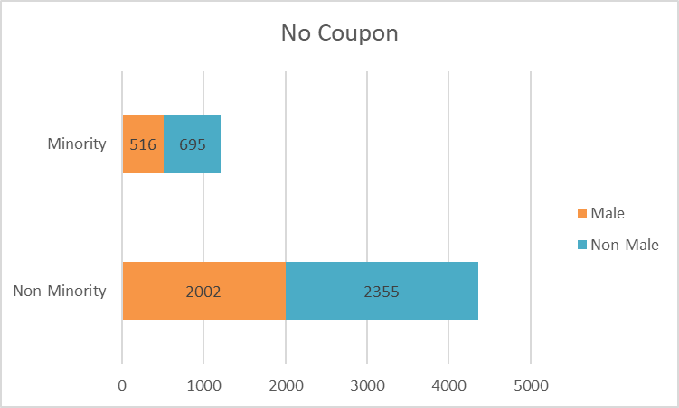
New Campaigns – Who Was Excluded?
93%
Of Sample
97%
Of Minority Customers
88%
Of Non-Male Customers

Slide 17

Revenue Projections
Dataset and Strategy | Projections
Old Dataset (5000) with Random Strategy | $38,296.62
Old Dataset (5000) with Our Strategy | $42,546.79
New Dataset (6000) with Our Strategy | $51,775.42
Notes:
The old dataset with the old strategy made $38,296. The old dataset with the new strategy would've made $25,237, BUT the new dataset with the new strategy is projected to make $51,775 – almost doubling what the old dataset would've made with only 1,000 more people (5000 vs 6000). Hard to say if it's a failure because the random couponing is a volatile strategy depending on who is on the website.

Slide 18



Ethics of New Campaign
Niche Group
Demographic
Targeting
Unintended
Bias

Slide 19



How to Proceed
Weigh
Ethics
Trial Run Strategy
Further Testing

Slide 20
Further Testing
1.
2.
3.
4.
5.
DEEP DIVE INTO CUSTOMER SEGMENTATION
REFINE TARGETING STRATEGY
ENHANCE THE ONLINE SHOPPING EXPERIENCE
ANALYZE AND INCORPORATE ADDITIONAL VARIABLES
REEVALUATE BUSINESS MODEL
Notes:
AG - To improve revenue, it might be beneficial to further segment customers to identify high-value groups. Next, refine the targeting strategy with personalized offers tailored to these segments. Then we enhance the online shopping experience by simplifying the user journey, making it easier to purchase. Analyze additional data to uncover hidden insights driving sales. Finally, reevaluate the business model—ensure pricing and loyalty programs align with customer needs. Together, these steps create a more cohesive strategy for sustained growth.

